Slide 1
Niner Transit Data
Sprint 2
Autumn Horrell, Felipe Orrego, Django Yepidan, Thien Nguyen, and Jaren Robbins

Slide 2
Overview
The Niner Transit system is a widely used transportation service provided by UNCC for students and faculty to use. However, with the exponential growth of riders, the system needs to adapt to the increasing efficiency standards.
Through analyzing the data given to us, we will visualize the information to make conclusions regarding the optimization of the transit system.

Slide 3
User Stories
Our completed user stories focus on visualizing the data and analyzing it by extracting specific values that are helpful to promote the efficiency of the Niner Transit System.
Our incomplete user stories are geared towards using the data visualizations created to optimize the transit system and create solutions to common problems/issues within the application.

Slide 4
User Stories Completed:
As a developer, I would like to write out the problem and generate a response. | The developer should be able to create a plan on how to visualize and eventually optimize the Niner Transit data. | Sprint 1 | Priority: 7th
As a developer, I would like to visualize each Niner Transit route to get a better idea of the problem. | Each route can be visualized on the Passio GO! App or the University website. | Sprint 1 | Priority: 3rd
As a student/driver, I would like to visualize how many people get on and off each stop each year. | We can use pandas to manipulate the data and extract the specific values that we want. | Sprint 1 | Priority: 2nd

Slide 5
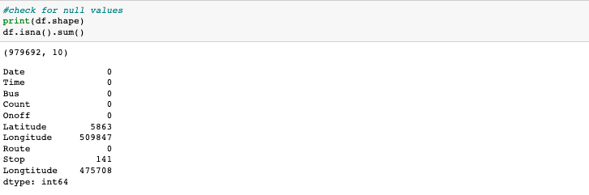
Prototype - Clean Data
As you can see above there is a huge presence of missing data in both Latitude and Longitude. Which suggests that we need to drop them.

Slide 6
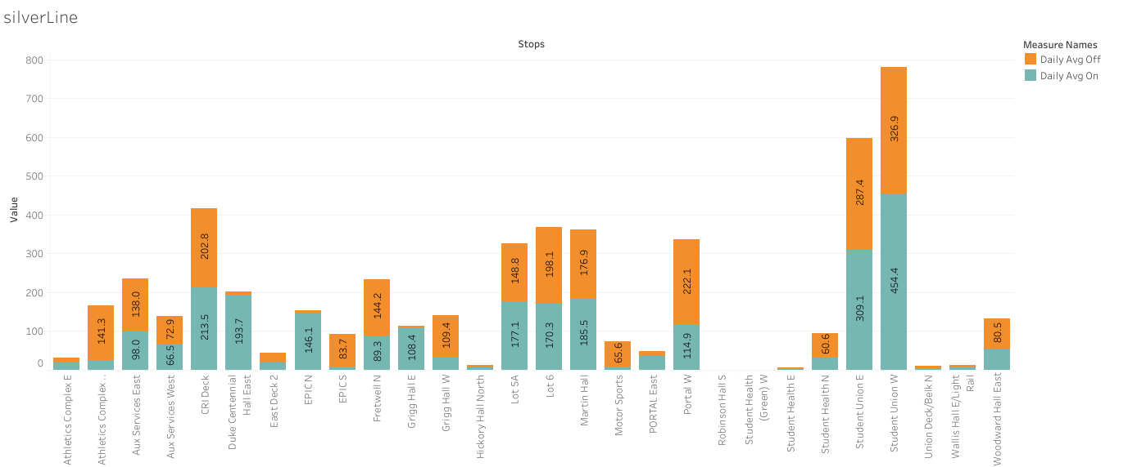
Prototype - Silver Line

Slide 7
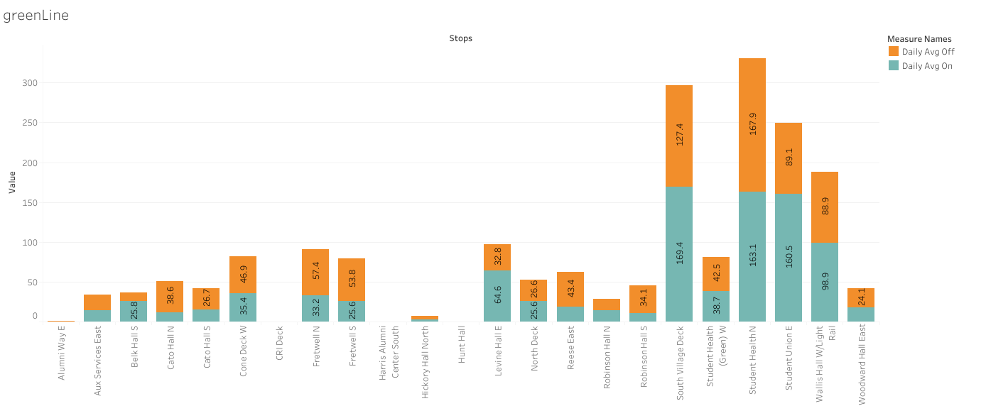
Prototype - Green Line

Slide 8
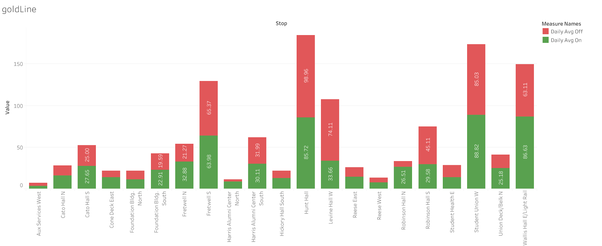
Prototype - Gold Line

Slide 9
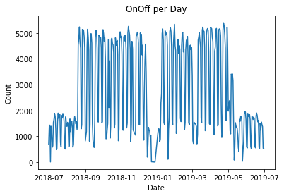
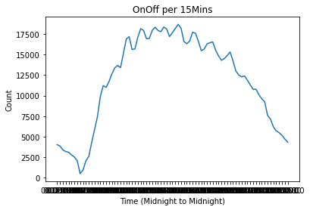
Prototype - On/Off Data
Total amount of individuals getting on and off a bus each day
Total amount of individuals getting on and off a bus every 15 minutes

Slide 10
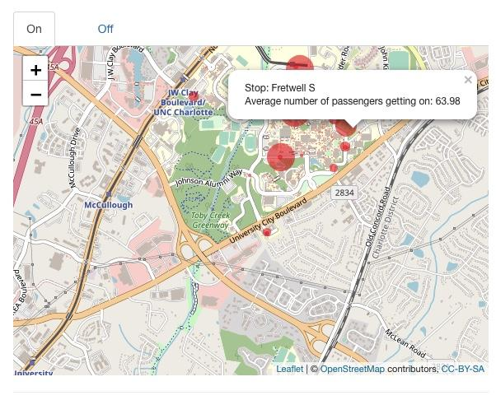
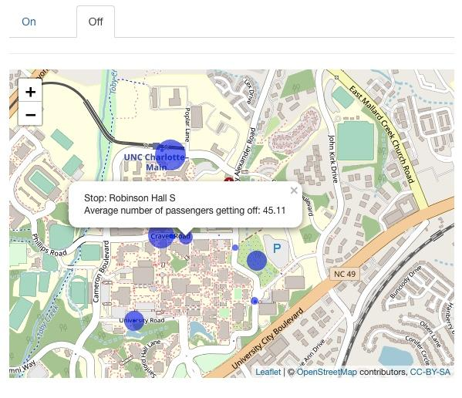
Prototype - Map Visualization
The interactive map with the location of each stop and the average number of passengers getting on at each stop
The interactive map with the location of each stop and the average number of passengers getting off at each stop
Link to my Shiny app where I showcase these interactive maps: https://dataanalystcharlotte.shinyapps.io/goldline/

Slide 11
Tools/Technologies Used
Python - Our main programming language. Within Python, we use various libraries to help us explore and visualize data:
Pandas - used for data manipulation and analysis.
Numpy - offers comprehensive mathematical functions and tools.
Matplotlib - used for static, animated, and interactive visualizations
MySQL - We are using SQL to answer questions that don’t require programming as queries are a bit easier to manage.
Leaflet for R - We use this to create interactive maps.
Streamlit - We have talked about using streamlit to host our proposal for the final project as it is very interactive and intuitive.

Slide 12
Next Steps
Preparing for Sprint 3 by further exploring our data and analyzing our graphs and visualizations to best optimize the transit system
Update and reference our user stories consistently to identify current issues or desired improvements
Begin the design documentation process
Start exploring options for how we can to present our proposal and which technologies would best fit our workflow

